Slide 1
Chapter 4 The von Neumann Model
计算机系统概论
Introduction to Computing Systems
（CS1002A.01）
苗付友
mfy@ustc.edu.cn 2022 Fall
计算机科学与技术学院
School of Computer Science and Technology

Slide 2
Outline
1
Review
2
From ENIAC to the Stored Program Computer
3
A Machine Structure：von Neumann Model
4
Summary

Slide 3
Outline
1
Review
2
From ENIAC to the Stored Program Computer
3
A Machine Structure：von Neumann Model
4
Summary

Slide 4
Review
MOS transistors are used as switches to implement logic functions.
N-type: connect to GND, turn on (with 1) to pull down to 0
P-type: connect to +2.9V, turn on (with 0) to pull up to 1
Basic gates: NOT, NOR, NAND
Logic functions are usually expressed with AND, OR, and NOT
Properties of logic gates
Completeness
can implement any truth table with AND, OR, NOT
DeMorgan's Law
convert AND to OR by inverting inputs and output

Slide 5
Review
We’ve touched on basic digital logic
Transistors
Gates
Storage (latches, flip-flops, memory)
State machines
Built some simple circuits
adder, subtracter, adder/subtracter，Incrementer
Counter (consisting of register and incrementer)
Hard-coded traffic sign state machine
Programmable traffic sign state machine
Up next: a computer as a state machine

Slide 6
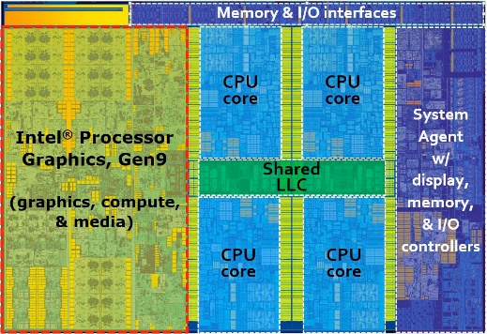

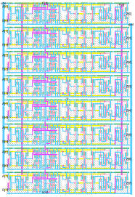
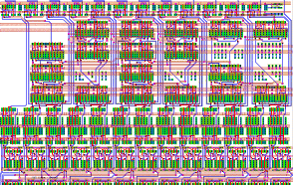
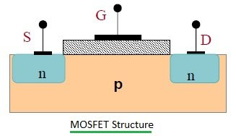
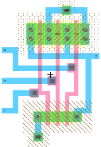
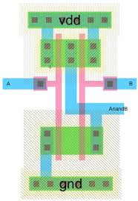
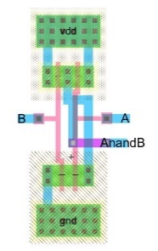
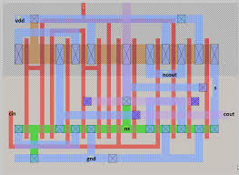
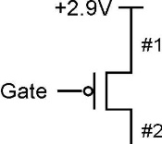
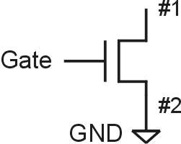
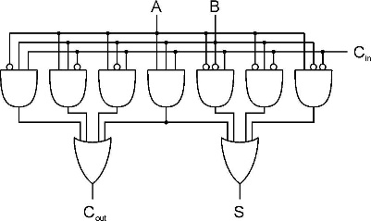
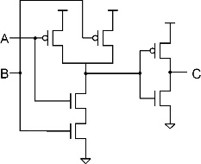
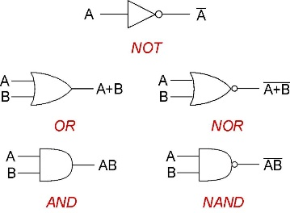

Bottom up approach
ALU
Full Adder
Integrated Circuit Design
100 Modules/ IC
0.25M~20G Devices
Register Transfer Level (RTL) Design
1K~10K Cells/Module
(100K Devices)
A
B
Cin
Gete Level Design
Transistor Physical Layout
+
Clk
Register
Cout
S
Scheme for
Representing Information
Circuit Level Design
（Transistor Level Design）
(2~8 Devices/Gate)
Register Transfer Level (RTL) Design
2~16 Gates/Cell
(16~64 Devices)

Slide 7
Today
Great Idea #2: Stored program computer(Von Neumann Model--A Machine Structure
Basic Components for a machine
The LC-3: An Example of von Neumann Machine
Instruction Processing

Slide 8

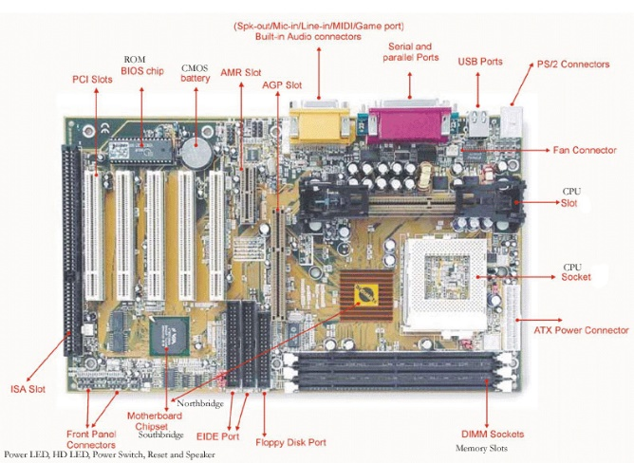

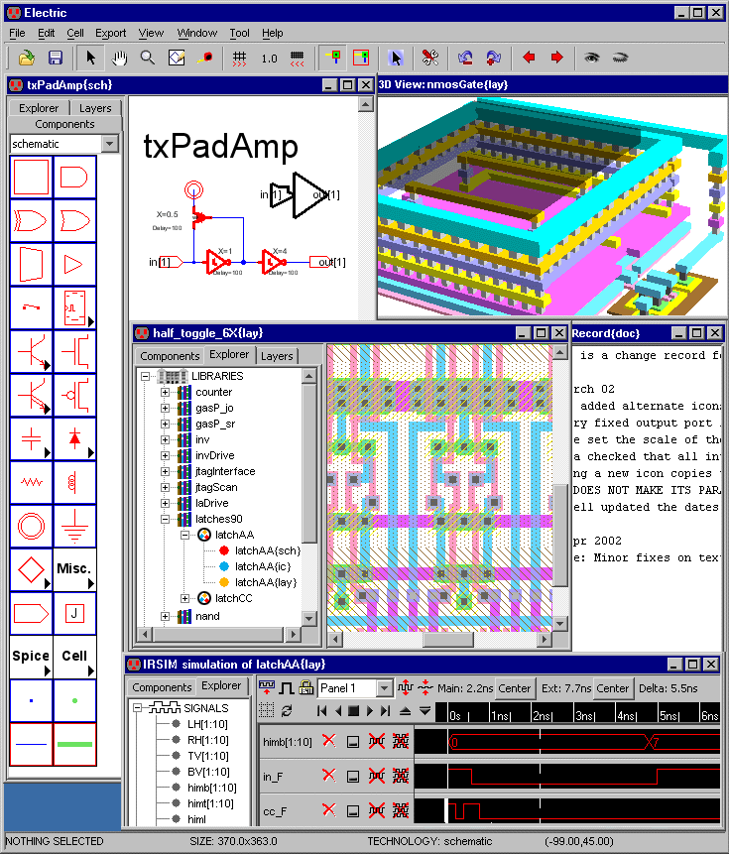
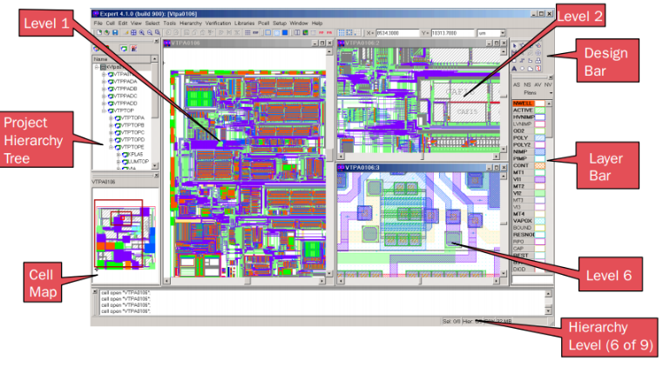
Bottom up approach
Personal Computer:
Hardware & Software Design
1~10PCBs/System
Motherboard Circuit Design
10 ICs/ PCB
1~50G Devices
Integrated Circuit Design
100 Modules/ IC
0.25M~20G Devices
Electronic System Level (ESL)Design
Now, You are Here.

Slide 9
Great Idea #3: Abstraction Helps Us Manage Complexity
Application
Solve a system of equations
Algorithm and Data Structure
Gaussian
elimination
Jacobi
iteration
Programming Language/Compiler
Red-black SOR
Multigrid
Operating System/Virtual Machines
Instruction Set Architecture (ISA)
FORTRAN
C
C++
Java
Microarchitecture
Sun SPARC
Intel x86
IBM PowerPC
Gates/Register-Transfer Level (RTL)
Pentium 4
Core 2 Duo
AMD Athlon X2
Analog/Digital Circuits
Electronic Devices
Ripple-carry adder
Carry-lookahead adder
Physics
Static CMOS
Dynamic CMOS
Nanomechanical

Slide 10
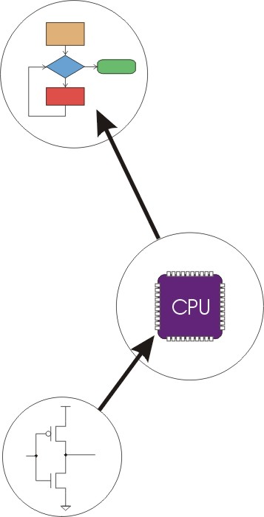
Great Idea #4: Software and Hardware Co-design
Application
Algorithm & Data Structure
Language
Software
Machine Architecture, ISA
Hardware
Microarchiture
Logic and IC
Now, You are Here.
Device
Computer System: Layers of Abstraction
Notes:
10

Slide 11
Outline
1
Review
2
From ENIAC to the Stored Program Computer
3
A Machine Structure：von Neumann Model
4
Summary

Slide 12

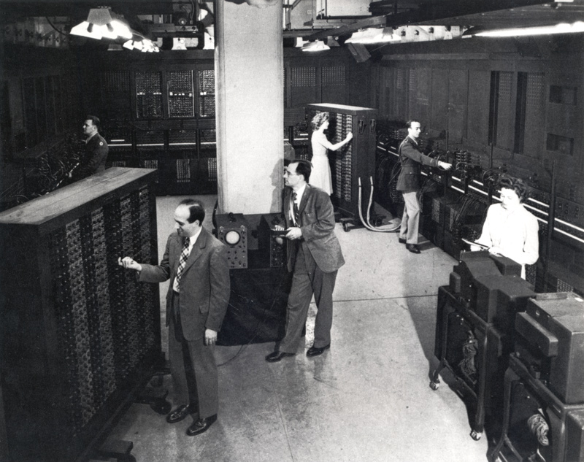
The First Electronic Computers

Slide 13
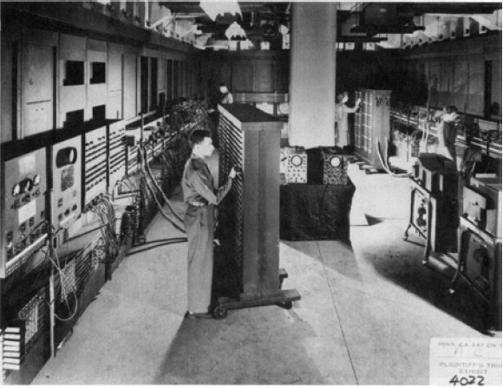
ENIAC - The first electronic computer ,1946年
Programmed by plugboard and switches, time consuming!

Slide 14

ENIAC - The first electronic computer ,1946年
Changing the program could take days!

Slide 15

The Origin of the Stored Program Computer
1944: ENIAC
Presper Eckert and John Mauchly -- first general electronic computer.
Hard-wired program -- settings of dials and switches.
1944: Beginnings of EDVAC
John von Neumann joined ENIAC team and proposed a stored program computer called EDVAC
1945: John von Neumann
John von Neumann wrote "First Draft of a Report on the EDVAC" in which he outlined the architecture of a stored-program computer.
failed to credit designers, ironically still gets credit
John von Neumann,
c. 1955 Credit: Computer History Museum
The basic structure proposed in the draft became known as the “von Neumann machine” (or model).
a memory, containing instructions and data
a processing unit, for performing arithmetic and logical operations
a control unit, for interpreting instructions

Slide 16
The Stored Program Computer Architecture (von Neumann Machine Architecture or Model)
Control Bus
Input
Devices
Memory
Output
Devices
Programs & Data
Data & Address Bus
Memory Data Register
Memory Address Register
Central Processing Unit
_{A}
_{B}
Registers
Arithmetic Logic Unit
Temporary
Memory
Control Unit
Program Counter
Instruction Register

Slide 17
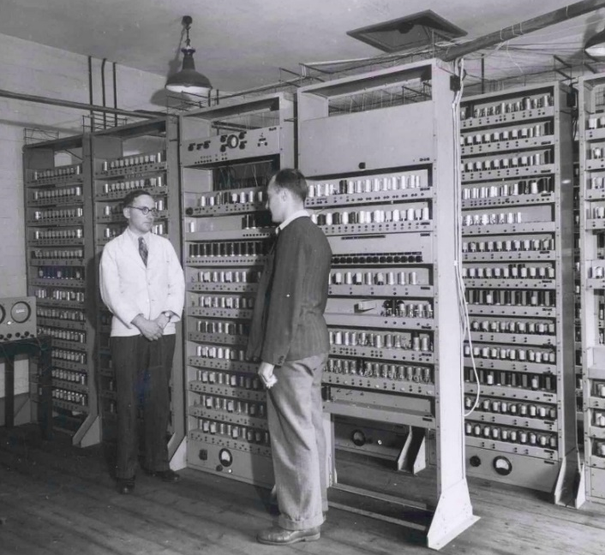
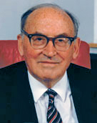
The Stored Program Computer
Maurice Vincent Wilkes
Electronic storage of programming information and data eliminated the need for the more clumsy methods of programming, such as punched paper tape — a concept that has characterized mainstream computer development since 1945.
EDSAC
University of Cambridge
UK, 1949

Slide 18
Two major inventions of the microprocessor chip
Stored program + Transistor technology
Change the program so that you can do all kinds of tasks on the same hardware
The device is smaller , faster and more reliability than a vacuum tube

Slide 19
Outline
1
Review
2
From ENIAC to the Stored Program Computer
3
A Machine Structure：von Neumann Model
4
Summary

Slide 20
von Neumann Model

Slide 21
F
D
EA
LC-3 Data Path
OP
₁₆
GatePC
₁₆
GateMARMUX
EX
LD.PC
PC
DR
₃
MARMUX
+1
REG FILE
₁₆
₂
PCMUX
₁₆
₁₆
₁₆
₁₆
₁₆
LD.REG
Control Unit
S
[7:0]
SR2
OUT
SR1
OUT
Processing Unit
SEXT
₊
SR2
₃
₃
SR1
ADDR2MUX
MUX
MUX
ADDR1MUX
₁₆
₁₆
[10:0]
₁₆
₁₆
₁₆
₁₆
₁₆
SEXT
[8:0]
LD.CC
₁₆
SEXT
FINITE STATE MACHINE
SR2MUX
[5:0]
SEXT
₁₆
N
Z
P
ALUK
_{A}
_{B}
[4:0]
SEXT
₂
ALU
LD.IR
IR
LOGIC
…
₁₆
₁₆
₁₆
RUN
GateALU
₁₆
GateMDR
₁₆
Memory Unit
LD.MDR
MDR
MEMORY
MAR
LD.MAR
₁₆
INPUT
OUTPUT
MIO.EN
MUX
₁₆
MEM.EN,R,W

Slide 22
Memory
0000
0001
0010
0011
0100
0101
0110
1101
1110
1111
00101101
•
•
•
10100010
k x m array of stored bits (k is usually 2^{k})(单个长度*数量）
Address
unique (n-bit) identifier of location
Contents
m-bit value stored in location
Basic Operations:
LOAD
read a value from a memory location
STORE
write a value to a memory location

Slide 23
Interface to Memory
How does processing unit get data to/from memory?
MAR: Memory Address Register
MDR: Memory Data Register
To read a location (A):（读取存储单元地址进入load)
Write the address (A) into the MAR.
Send a “read” signal to the memory.
Read the data from MDR.
To write a value (X) to a location (A):
Write the data (X) to the MDR.(这是要传递的内容，所以需要MDR)
Write the address (A) into the MAR.
Send a “write” signal to the memory.
(收到信号后把MDR中的内容写入）(D触发器的写允许）

Slide 24
Processing Unit
Functional Units
ALU = Arithmetic and Logic Unit(容量小，只有几个寄存器）
could have many functional units. some of them special-purpose (multiply, square root, …)
LC-3 performs ADD, AND, NOT
Registers(寄存器组）
Small, temporary storage（小，但宽度一致）
Operands and results of functional units(存储操作数和结果）
LC-3 has eight register (R0, …, R7)
Word Size
number of bits normally processed by ALU in one instruction
also width of registers
LC-3 is 16 bits

Slide 25
Input and Output(interface——接口）（Console接口是典型的配置接口）
Devices for getting data into and out of computer memory
Each device has its own interface, usually a set of registers like the memory’s MAR and MDR(寄存器自己也有地址）
LC-3 supports keyboard (input) and console (output)
keyboard: data register (KBDR) and status register (KBSR)
console: data register (CRTDR) and status register (CRTSR)
frame buffer: memory-mapped pixels
Some devices provide both input and output
disk, network(disk——磁盘）
Program that controls access to a device is usually called a driver.
Notes:
25

Slide 26
Control Unit
Orchestrates execution of the program
Instruction Register (IR) contains the current instruction.
Program Counter (PC) contains the address of the next instruction to be executed.(程序计数器）（实现读取程序并一条一条执行）
Control unit:
reads an instruction from memory
the instruction’s address is in the PC
interprets the instruction, generating signals that tell the other components what to do
an instruction may take many machine cycles to complete

Slide 27
Instruction Processing（State Transition）
F
Fetch instruction from memory
D
Decode instruction
EA
Evaluate address
OP
Fetch operands from memory
EX
Execute operation
S
Store result
Notes:
27

Slide 28
Instruction
The instruction is the fundamental unit of work.
Specifies two things:
opcode: operation to be performed(操作码）
operands: data/locations to be used for operation(操作数）
An instruction is encoded as a sequence of bits. (Just like data!)
Often, but not always, instructions have a fixed length, such as 16 or 32 bits.
Control unit interprets instruction: generates sequence of control signals to carry out operation.
Operation is either executed completely, or not at all.
A computer’s instructions and their formats is known as its Instruction Set Architecture (ISA).
Persistent ISA invented by UW grad Gene Amdahl (IBM 360)

Slide 29
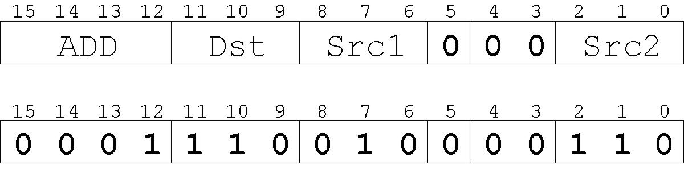
Example: LC-3 ADD Instruction
在2号寄存器存放
在6号寄存器存放
“Add the contents of R2 to the contents of R6, and store the result in R6.”
(把2号和6号寄存器中的数据相加，然后存入6号）
LC-3 has 16-bit instructions.
Each instruction has a four-bit opcode, bits [15:12].
LC-3 has eight registers (R0-R7) for temporary storage.
Sources and destination of ADD are registers.

Slide 30
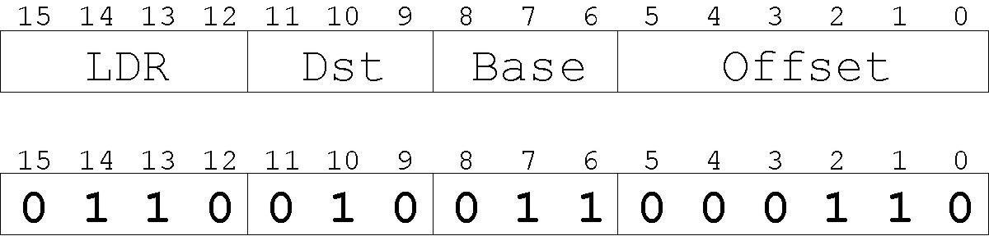
Example: LC-3 LDR Instruction
Load instruction -- reads data from memory
Base + offset mode:
add offset to base register -- result is memory address
load from memory address into destination register
“Add the value 6 to the contents of R3 to form a memory address. Load the contents stored in that address to R2.”(寄存器相对寻址方式）

Slide 31
Instruction Processing: FETCH
F
D
EA
OP
EX
S
Load next instruction (at address stored in PC) from memory into Instruction Register (IR).
Load contents of PC into MAR.
Send “read” signal to memory.
Read contents of MDR, store in IR.
Then increment PC, so that it points to the next instruction in sequence.
PC becomes PC+1.(执行后自动+1）

Slide 32
Instruction Processing: DECODE(译码)
F
D
EA
OP
EX
S
First identify the opcode.
In LC-3, this is always the first four bits of instruction.
A 4-to-16 decoder asserts a control line corresponding to the desired opcode.
Depending on opcode, identify other operands from the remaining bits.
Example:
for ADD, last three bits is source operand #2
for LDR, last six bits is offset

Slide 33
Instruction Processing: EVALUATE ADDRESS(地址计算)
F
D
EA
OP
EX
S
For instructions that require memory access, compute address used for access.
Examples:
add offset to base register (as in LDR)
add offset to PC (or to part of PC)
add offset to zero

Slide 34
Instruction Processing: FETCH OPERANDS(取操作数)
F
D
EA
OP
EX
S
Obtain source operands needed to perform operation.
Examples:
read data from register file (ADD)
load data from memory (LDR)

Slide 35
Instruction Processing: EXECUTE(执行)
F
D
EA
OP
EX
S
Perform the operation, using the source operands.
Examples:
send operands to ALU and assert ADD signal
do nothing (e.g., for loads and stores)

Slide 36
Instruction Processing: STORE
Write results to destination. (register or memory)
Examples:
result of ADD is placed in destination register
result of memory load is placed in destination register
for store instruction, data is stored to memory
write address to MAR, data to MDR
assert WRITE signal to memory
F
D
EA
OP
EX
S

Slide 37
Changing the Sequence of Instructions
In the FETCH phase, we incremented the Program Counter by 1.
What if we don’t want to always execute the instruction that follows this one?
examples: loop, if-then-else, function call
Need special instructions that change the contents of the PC.
These are called jumps and branches.
jumps are unconditional -- they always change the PC
branches are conditional -- they change the PC only if some condition is true (e.g., the contents of a register is zero)

Slide 38
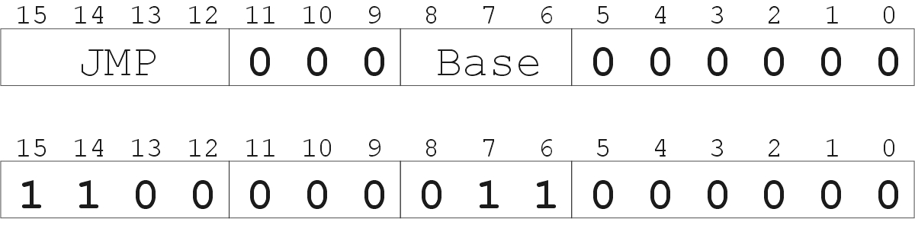
Example: LC-3 JMP Instruction
“Load the contents of R3 into the PC.”
Set the PC to the value contained in a register. This becomes the address of the next instruction to fetch.
Notes:
38

Slide 39
Driving Force: The Clock
“1”
“0”
Machine
Cycle
time→
The clock is a signal that keeps the control unit moving.
At each clock “tick,” control unit moves to the next machine cycle -- may be next instruction or next phase of current instruction.
Clock generator circuit:
Based on crystal oscillator
Generates regular sequence of “0” and “1” logic levels
Clock cycle (or machine cycle) -- rising edge to rising edge

Slide 40
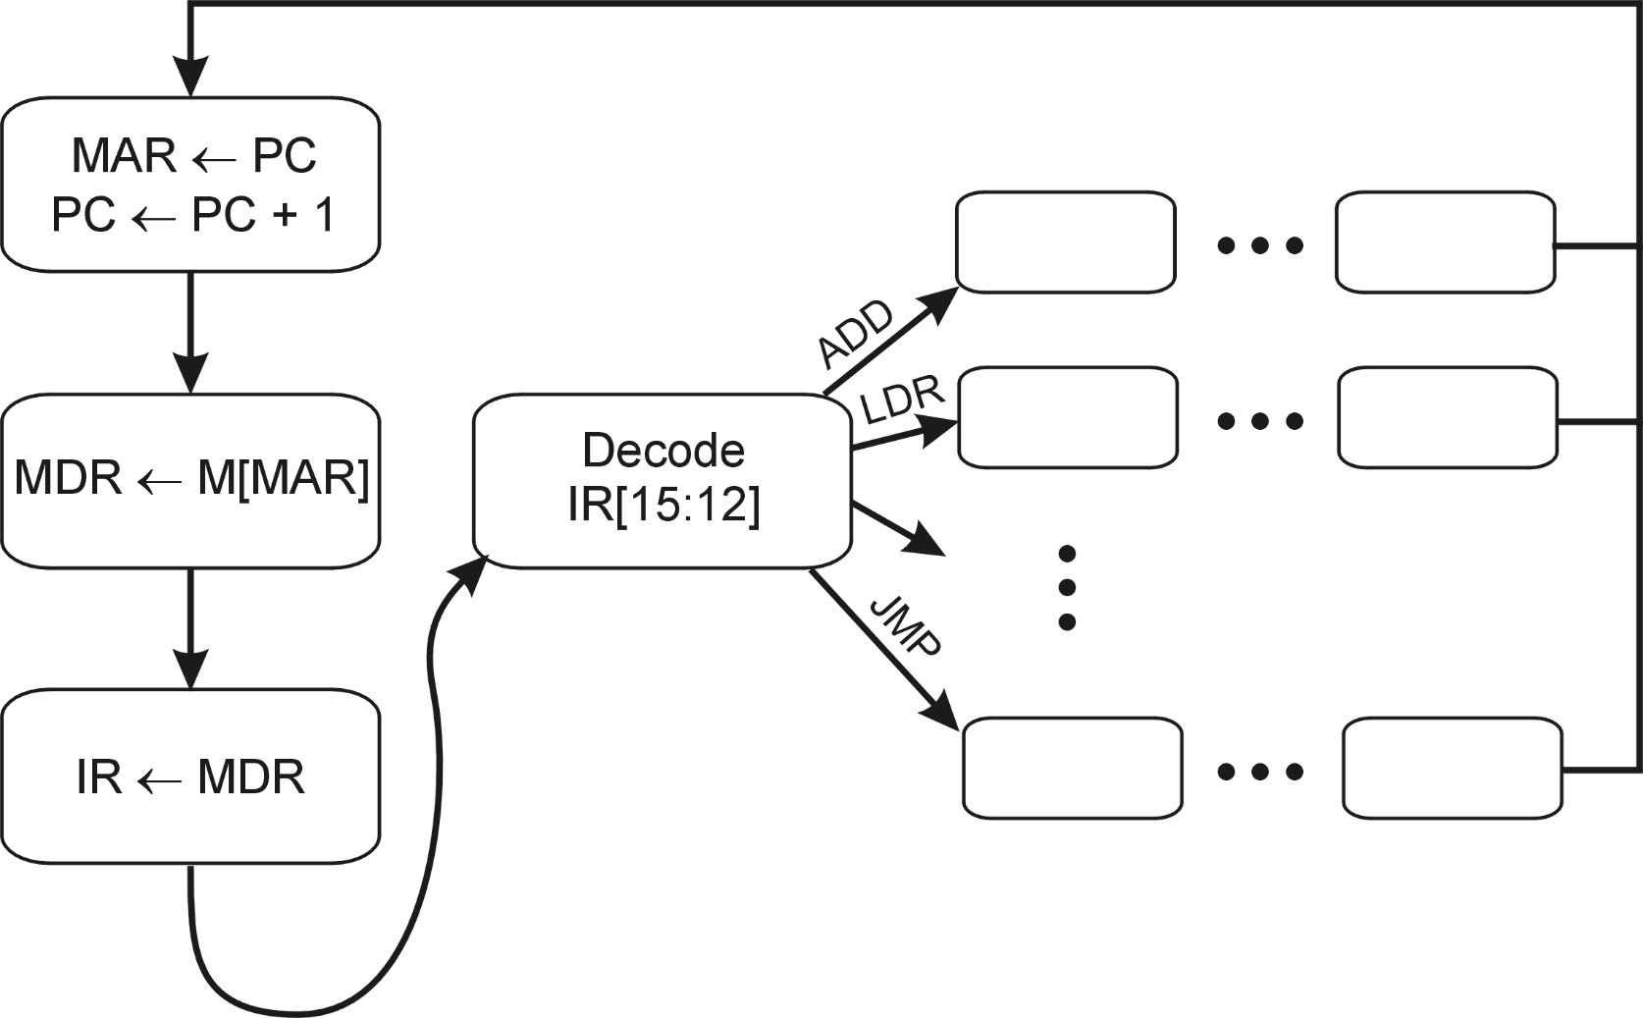
Control Unit State Diagram
The control unit is a state machine. Here is part of a simplified state diagram for the LC-3:
A more complete state diagram is in Appendix C.
It will be more understandable after Chapter 5.

Slide 41
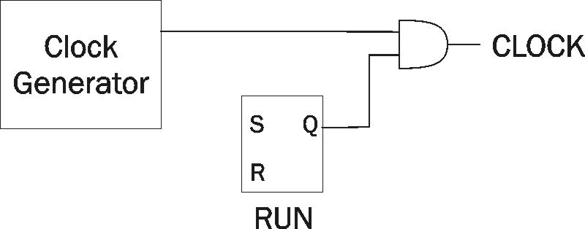
Stopping the Clock
Control unit will repeat instruction processing sequence as long as clock is running.
If not processing instructions from your application, then it is processing instructions from the Operating System (OS).
The OS is a special program that manages processor and other resources.
To stop the computer:
AND the clock generator signal with ZERO
when control unit stops seeing the CLOCK signal, it stops processing

Slide 42
Outline
1
Review
2
From ENIAC to the Stored Program Computer
3
A Machine Structure：von Neumann Model
4
Summary

Slide 43
Von Neumann Model

Slide 44
Instruction Processing Summary
F
D
EA
OP
EX
S
Instructions look just like data -- it’s all interpretation.
Three basic kinds of instructions:
computational instructions (ADD, AND, …)
data movement instructions (LD, ST, …)
control instructions (JMP, BRnz, …)
Six basic phases of instruction processing:
not all phases are needed by every instruction
phases may take variable number of machine cycles

Slide 45
LC-3 Data Path

